Slide 1
Lab.2 Tablet dosage form
Suhair Alawaad
-BSc. Pharm (Uni. of Basra College of Pharmacy);
-MSc. IPSci. (Brighton University, School of Pharmacy and Biomedical Sciences; UK)

Slide 2
Introduction
Tablet is a unit solid dosage which is usually prepared with the aid of suitable pharmaceutical excipients and it contains a single usual dose.
Notes:
Without question, the compressed tablet is one of the most popular dosage forms today. About one-half of all prescriptions dispensed are for tablets. Usually one considers a compressed tablet as an oral medication; however, tablets have many other uses. The sublingual tablet, the pellet, the wafer, the troche, and the vaginal insert are manufactured by the same procedure as an oral tablet.

Slide 3
The Route of administration of tablets:
The most common one is (????)
Notes:
Oral
Sublingual
Vaginal
Implantable

Slide 4
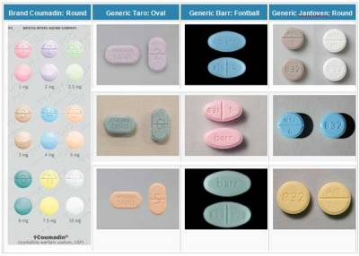
More than 50% of formulations are tablets. Why?????
Patient acceptability due to:
( Portability, Hard to tamper with tablets, Easy to swallow, especially if coated.)
Relatively easy to manufacture and package
Provide accurate dosing
Increased stability of the drug when compared to liquid dosage forms.
Product identification is easy especially with use of imprints.
Can be enteric coated or designed for delayed release.
Notes:
What dose tamper means?
Tablets are the common dosage form available in the market due to its desirable advantages which include the following:
Patient acceptability:
Noninvasive
Portability
Hard to tamper with tablets
Easy to swallow, especially if coated.
Relatively easy to manufacture and package
Provide accurate dosing
Increased stability of the drug when compared to liquid dosage forms.
Product identification is easy especially with use of imprints.
Can be enteric coated or designed for delayed release.

Slide 5
Disadvantage (are few)
Formulation difficulties, if drug resist compression.
Some drugs have poor wetting or poor water solubility or poor dissolution which might affect the drug’s bioavailability.
Q/Suggest an alternative dosage form??
Bitter taste of the drug might require coating.
Not suitable for liquid drugs.
Notes:
I could say suspension might improve wettability,

Slide 6
Tablet Excipients :
What They are?????
Excipients→ improve the physical properties of the tablet.
Excipients includes:
1)Fillers (diluents) → used to increase the bulk of the tablet . it is generally not feasible to make tablets with a weight of less than about 70 mg. It is essential that fillers be inert and stable .
A - Soluble : lactose , sucrose , mannitol , sorbitol .
B- Insoluble: calcium sulfate , dicalcium phosphate , tricalcium phosphate , starch , calcium carbonate
Filler must be:
Having good flowability and compressibility,
Inert, cheap, tasteless, able to disintegrate
Notes:
The diluent must be :
Having good flowability and compressibility,
Inert, cheap, tasteless, able to disintegrate
E.g;
anhydrous lactose,
dicalcium phosphate (Emcompress),
granulated mannitol,
microcrystalline cellulose (Avicel),
compressible sugar (Di-Pac),
starch (Sta-Rx 1500),
hydrolyzed starch (Celutab),

Slide 7
2)Binders : the substance that glue powders together and cause them to form granules are the binders or adhesives. They are either sugars or polymeric materials. Examples
Water
Ethanol ,
- Acacia mucilage (10-20%) and it gives hard ,friable granules ,
-Tragacanth mucilage (10-20%) ,
- Gelatin solutions (2-10%) , they are strong sdhesive ,use warm.
-Starch mucilage (5-10 %) , one of the best general adhesieves ,use warm.
Glucose syrup (25-50%) , strongly adhesive , tablet may soften in high humidity
PVP(3-15%)
Cellulose derivative (5-10 %)

Slide 8
3) Lubricants ,glidents and anti – adherents : they prevent the most common problem during tableting.(the flow of granulation , the adhesion of material to the punches and dies , and release of the tablet from the press.)
Lubricants : Are those agents that the friction between the tablet edge and die wall during the ejection cycle . e.g. magnesium stearate - Lubricants are usually added at the very last step before compression , since they must be present on the surfaces of the granules between them and the parts of the tablet press .
Glidants : Are materials that improve the flow characteristics of granulation e.g. talc.
Anti – adherents : Function to prevent tablet granulation from sticking to faces of the punches and the die walls e.g. talc .

Slide 9
4) Disintegrants :
Is added for the purpose of causing the compressed tablet to break apart when placed into an aqueous environment .
Method of adding disintegrant :
It is better to add it in two portions , one half is added to the powdered components before the wet granulation process and the remaining portion is added to the finished granulation just prior to the compression . This method hold that a disintegrent is required between the granules as well as within them Some of the commonly used disintegrant
- Starch (5-20% w/w ) - Avicel (5-20 % w/w) - Algenic acid (5-10 %w/w) - Veegum (5-15 % w/w) - Bentonite ( 5-15 % w/w)
5)Preservatives
6)Flavouring agents
7)Film formers
8)Opacifiers and colours
Q/Prescribe the function of each and give at least 2 examples for each one

Slide 10
Manufacturing method
Direct compression
The drug itself is compressible and/or it can be mixed with a filler that is compressible (e.g. lactose).
Has a good flow properties
Dry granulation
The powder mixture of the drug and excipients is granulated prior to compression. Granulation is by either methods:
Wet granulation
Dry granulation
In all of these methods the active ingredient is usually mixed with other inactive ingredients (excipients).
Excipients improve the physical properties of the tablet.
Notes:
Direct compression
The drug itself is compressible and/or it can be mixed with a filler that is compressible (e.g. lactose).
Has a good flow properties
Wet granulation
The powder mixture of the drug and excipients is granulated by wet methods prior to compression.
Dry granulation
The powder mixture of the drug and excipients is granulated by dry methods prior to compression.
In all of these methods the active ingredient is usually mixed with other inactive ingredients (excipients).
Excipients improve the physical properties of the tablet.
Compressed tablets may be manufactured by three basic methods: wet granulation, dry granulation, and direct compression. Wet granulation is a widely used method for the production of compressed tablets Why?.
The dry granulation method (slugging method) The ingredients in the formulation are intimately mixed and precompressed on heavy duty tablet machines. The slug which is formed is ground to a uniform size and compressed into the finished tablet.
The wet granulation method This method has more operational manipulations, and is more time-consuming than the other methods. The wet granulation method is not suitable for drugs which are thermolabile or hydrolyzable by the presence of water in the liquid binder. The general steps involved in a wet granulation process are:
The powdered ingredients are weighed and mixed intimately by geometric dilution.
The granulating solution or binder is prepared.
The powders and the granulation solution are kneaded to proper consistency.
The wet mass is forced through a screen or wet granulator.
The granules are dried in an oven or a fluidized bed dryer.
The dried granules are screened to a suitable size for compression.
A lubricant and a disintegrating agent are mixed with the granulation.
The granulation is compressed into the finished tablet.

Slide 11
Direct Compression
All the materials are blended together and sieved then compressed directly.
Properties of directly compressed materials
The API itself is compressible and/or it can be mixed with a filler that is compressible (e.g. lactose).
API should have a good flow properties
Notes:
there is no any intermediate properties

Slide 12
Limitations of direct compression
There are only Few crystalline substances such as sodium chloride, sodium bromide and potassium chloride that may compressed directly.
Most materials have low intermolecular attraction forces ( cohesion) which minimize compression.
Compression of single substance might produce very hard tablet which needs addition of other excipient(s).→ These excipients might affect on compressibility.
For small doses drugs, it is not practical to achieve a uniform blend from the API and the coarser diluent. Therefore, granulation is most suitable.

Slide 13
Limitations of direct compression (continued)
Difference in particle size and bulk properties might lead to non uniformity in content, particularly, for low doses drugs
Interaction with diluent as for interaction between amine compounds and spry dried lactose
The dry conditions might build up a static charge which might negatively affect the mixing state.
It is suitable for only large doses drugs; however, the compressible drugs are limited

Slide 14
General procedure for direct compression
Blending of all ingredients
Sieving through X mesh size
Compression via tableting machine

Slide 15
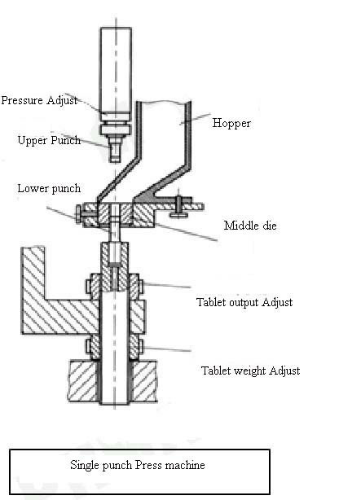
Single Punch Tablet Machines
Consist of hopper which deliver the powder blend into the die
The die which gives the size and shape of the tablet
The upper punch and lower punch are moving to fill the die and eject the tablet
Notes:
Single Punch Tablet Machines
Tableting machines are commonly used in pharmaceutical industry. They are high-speed machines that create thousands of tablets in a small period. The compounding pharmacist uses a variation of these machines. It is called a single-punch tablet press and makes one tablet at a time. A "punch" has two pieces of casted tubular metal. The bottom metal piece has a small cavity in one end of the tube; the top metal piece has one end that is tapered into a small rod that will just fit into the small cavity in the other piece. The rod does not go all the way to the bottom of the cavity, but leaves a small gap. The punch is fitted into a press so that when the handle is depressed and released, the rod goes into and then comes out of the bottom piece. To make a tablet, the powder material is placed into the bottom piece, and the handle is depressed and released. The powders are compressed and occupy the size of the gap designed in the punch.
Punches come in many sizes which allows the production of tablets of different sizes and compression strengths. But each punch is a matched set; it is not possible to interchange the top and bottom pieces of different punches.
Chewable tablets, effervescent tablets, and compressed tablets can be made using a tablet press. Chewable tablets are generally made using mannitol because it has a sweet, cooling taste and is easy to manipulate. Other ingredients may include binders (e.g., acacia), lubricants (e.g., stearic acid), colors, and flavors. The powder mixture is prepared, the desired quantity of mixture is weighed, and then pressed with a single-punch tablet machine.
Effervescent tablets generally contain ingredients such as tartaric acid, citric acid, and sodium bicarbonate. These powders would be appropriately mixed and pressed into tablets using the same procedure as chewable tablets. They will not require a disintegrant since they will effervesce when placed in water. Compressed tablet mixtures generally contain the active drug, a diluent (e.g., lactose), a disintegrant (e.g., starch), and a lubricant (e.g., 1% magnesium stearate).

Slide 16
Direct compression
Metronidazole 200 mg
Lactose 100 mg
Mg. Stearate 1%
Prep. 10 tablets
Weigh the required amount of metronidazole and lactose to prepare 12 tablets and mix them geometrically. Avoid grinding (why??).
Pass through 30 mesh size sieve. (Why?)
Add the required amount of lubricant and mix for not more than 5 minutes. (Mixing time is critical should not exceed 5 min. (explain).
Compress directly with tableting machine.

